Slide 1
DECISION MAKING MULTIPLE CHOICE QUESTIONS

Slide 2
1.
Geeks
Quiz
GeeksQuiz
Error
Answer: C
What is the output of the below program?
#include <stdio.h> int main() { int i = 0; switch (i) { case '0': printf(“Geeks"); break; case '1': printf(“Quiz"); break; default: printf(“GeeksQuiz"); } return 0; }

Slide 3
Guess the output of the following program :
#include<stdio.h>
int main( )
{
int x = 10;
float y = 10.0;
if(x == y)
printf("x and y are equal");
else
printf("x and y are not equal");
return 0;
}
2.
x and y are equal B. Run time error
C. Compile time error D. x and y are not equal
Answer: A

Slide 4
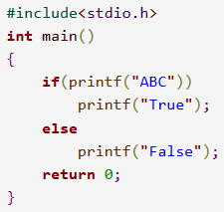
3. Predict the output of the program ?
ABC True B. False
C. ABC D. Error
Answer: A

Slide 5
4. What is the output of the following code?
A. hi B. hello
C. no D. None of the options
Answer: A
#include <stdio.h>
int main()
{
int x = 5;
if (x < 1)
printf("hello");
if (x == 5)
printf("hi");
else
printf("no");
return 0;
}

Slide 6
5. What is the output ?
a=0,b=0,c=0 B. a=0,b=10,c=10
C. a=10,b=10,c=0 D. a=10,b=10,c=10
Answer: C
#include<stdio.h>
int main()
{
int a=3,b,c;
b=a=10;
c=a<10; printf("a=%db=%dc=%d\n",a,b,c);
return 0;
}

Slide 7
A "switch" statement is used to :
A. | Switch between functions in a program
B. | Switch from one variable to another variable
C. | To choose from multiple possibilities which may arise due to different values of a single variable
D. | All of above

Slide 8
7. Consider following program fragment:
if (a > b)
printf("a> b") ;
else
printf ("else part") ;
printf("a< = b");
a <= b will be printed if
A. a>b
B. a < b
C. a=b
D. All the above

Slide 9
8. The following program fragment
if (a = 0)
printf ("a is zero");
else
printf ("a is not zero");
results in the printing of
A. a is zero
B. a is not zero
C. nothing
D. garbage

Slide 10
9. If switch feature is used, then:
A. default case must be present
B. default case, if used, should be the last case
C. default case, if used, can be placed anywhere
D. none of the above

Slide 11
10. The switch feature:
A. can always be replaced by a nested it-then-else clause
B. enhances logical clarity
C. can't always be replaced by a nested if -then-else clause
D. Both (a) and (b)

Slide 12
11. Break statement can be simulated by using
A. goto
B. return
C. exit
D. any of the above features

Slide 13
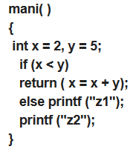

12. Consider the following program:
A. output is z2
B. output is z1z2
C. this will result in compilation error
D. Nothing will be printed

Slide 14
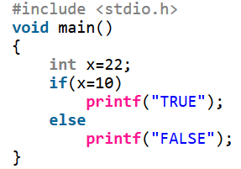
13. What will be the output of following program ?
A. TRUE
B. FALSE
C. Error
D. None

Slide 15
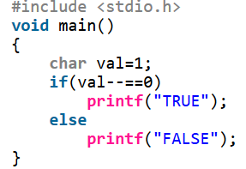
14. What will be the output of following program ?
A. FALSE
B. Error
C. TRUE
D. None

Slide 16
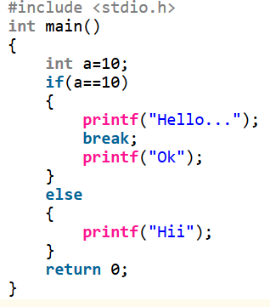
15. What will be the output of following program ?
Hello...
Hello...OK
OK
Error

Slide 17
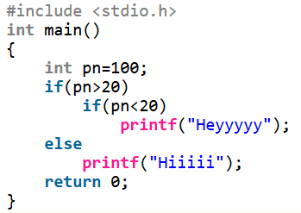
16. What will be the output of following program ?
No output
Hiiiii
Heyyyyy
HeyyyyyHiiiii

Slide 18

17. Which of the following are incorrect statements?
If int a=10.
3 and 4
3 only
4 only
2,3 and 4

Slide 19
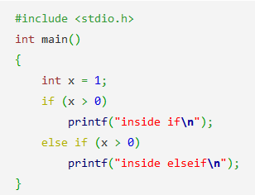
18. What is the output of this C code?
inside if
inside elseif
inside if
inside elseif
compile time error

Slide 20
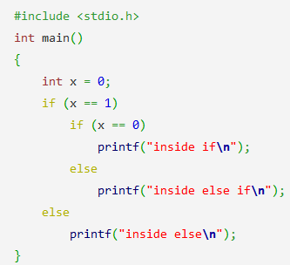
19. What is the output of this C code?
inside if
inside else If
inside else
compile time error

Slide 21
20. Switch statement accepts.
A. int
B. char
C. long
D. all of the mentioned

Slide 22
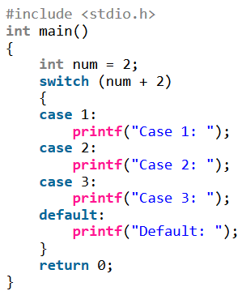
21. Find the output:
Case 1:
Case 2:
Case 3:
Default:

Slide 23
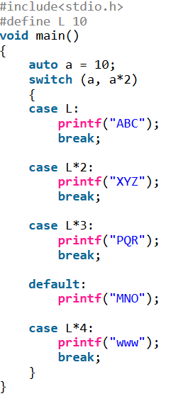
22. The output is :
ABC
XYZ
PQR
MNO
WWW

Slide 24

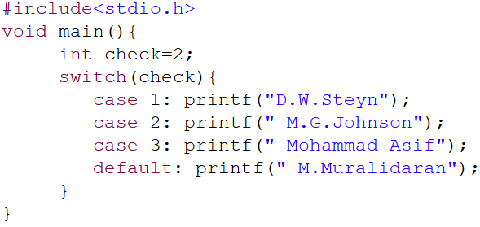
23. What will be output when you will execute following c code?
A. M.G.Johnson B. M.Muralidaran
C. M.G.Johnson Mohammad Asif M.Muralidaran D. Compilation error

Slide 25
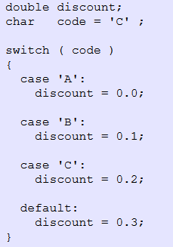
24. What value is assigned to discount ?
0.0 B. 0.1
C. 0.2 D. 0.3

Slide 26
25. What are the valid places to have keyword “Break”?

Slide 27
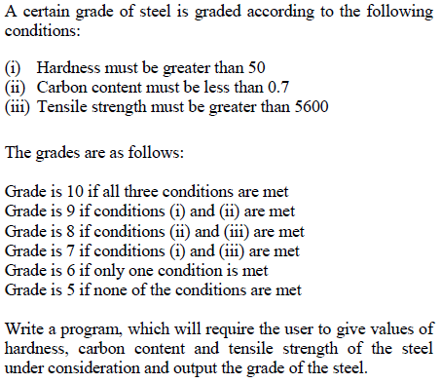
26.

Slide 28
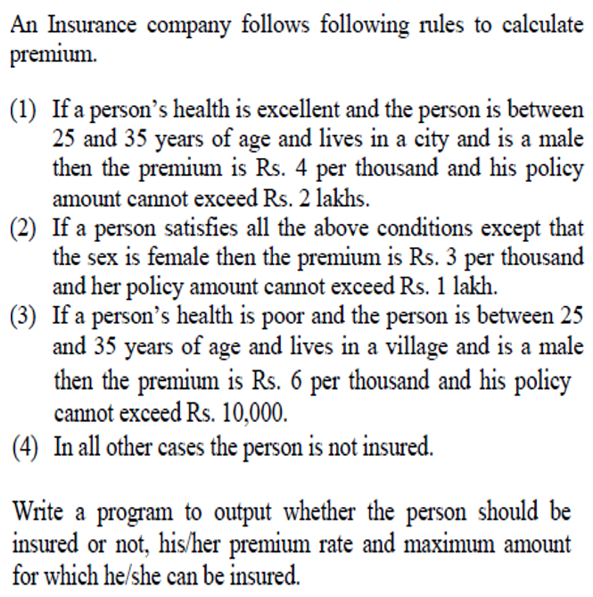
27.

Slide 29
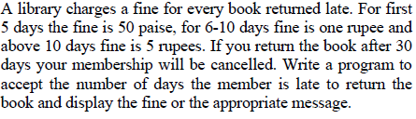
28.

Slide 30
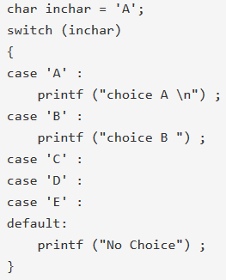
29. What will be the output of the following C program segment? [GATE 2012]
No choice
Choice A
Choice A
Choice B No choice
Program gives no output as it is
erroneous

Slide 31
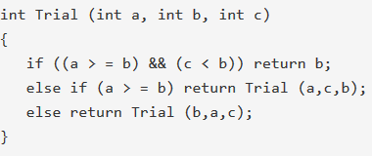
30. Consider the following C function definition: [GATE 2000]
The function Trial:
A. Finds the maximum of a, b, and c.
B. Finds the minimum of a, b and c
C. Finds the middle number of a, b, c
D. None of the above

Slide 32

31. Consider the following recursive C function that takes two arguments:
[GATE 2011]
What is the return value of the function foo when it is called as foo(345, 10) ?
A. 345 B. 12 C. 5 D. 3

Slide 33
ANSWERS

Slide 34
1.At first look, the output of the program seems to be Geeks. But, the cases are labeled with characters which gets converted to their ascii values 48(for 0) and 49(for 1). None of the cases is labeled with value 0. So, the control goes to the default block and GeeksQuiz is printed.
2. X and y are equal.
3. ABCTrue
A
C
C
D. The else clause has no brackets i.e., {and}. This means the else clause is made up only one statement. So, printf ("a < = b"); will be executed anyway, i.e. if a>b a< = b. Hence the answer
B
C
D
C exit key word. because it alts the program and control transferes to next executive statement as same as break statement.
D. because return keyword is used; if return was not used then output will be z

Slide 35
13. TRUE because if(x=10)... "=" is an assignment operator, so 10 will be assigned to x and condition will be true due to if(10)..
14. A.
15. D. Error : misplaced break/ illegal break.A break statement can be used with looping and switch statements.
16. B. printf("Hiiiii"); that is written after else , is treated as else part of inner if condition if(pn<20).
17. C. Consider the following expressions:
if(a==10) => if(1) => correct.
if(10==a) => if(1) => correct.
if(a=10) => if(10) => correct (10 is a non zero value).
if(10=a) => incorrect, because value of a can not assign in 10, Lvalue required error is occurred.
18. A. Because condition matches thus compiler doesn’t execute else part.
19. C.
20. D.
21. D. In switch, an expression “num+2” where num value is 2 and after addition the expression result is 4. Since there is no case defined with value 4 the default case got executed.
22. B. because comma is also operator with least precedence. So if
x = (a, b);
Then x = b
23. C. If we will not use break keyword, in each case the program control will come in each case after the case which satisfy the switch condition.

Slide 36
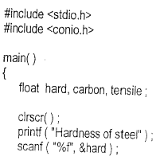
24. C&D. because break keyword has not been used.
25. The purpose of the Break keyword is to bring the control out of the code block which is executing. It can appear only in Looping or switch statements.
26.

Slide 37
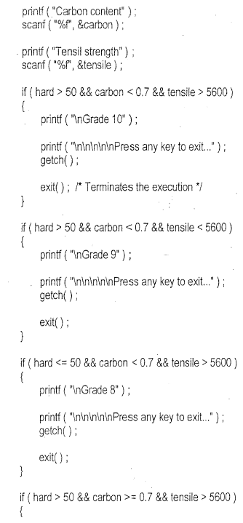
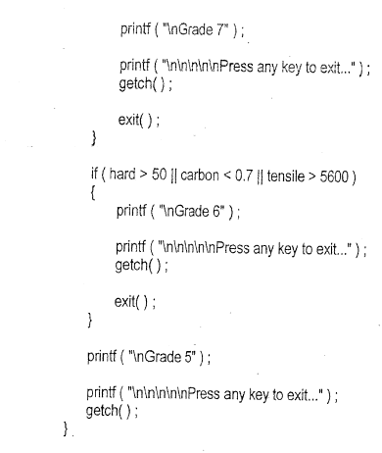

Slide 38
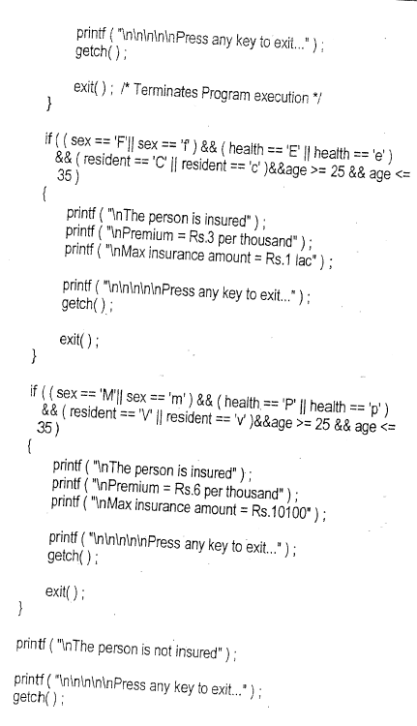
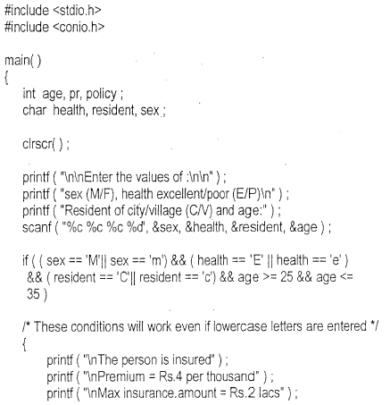
27.

Slide 39
29. C. In switch statement if a case is executed and if the case doesn't contain break, then all the subsequent 'case' statements are executed until a break statement is found.
30. C. The first condition, (a > = b) && (c < b), if true will return the middle number, i.e. b. Again on calling the Trial function, it will return the middle number.
31. B.
foo(345,10) = 5 + [ foo(34,10) ]
= 5 + [ 4 + { foo(3,10) } ]
= 5 + [ 4 + { 3 + foo(0,10) } ] = 5 + 4 + 3 + 0 = 12
Therefore, foo function returns sum of digits in the number n, because r = 10.

